Slide 1


Compile your code!!
Oneil Hsiao
2019-04-09

Slide 2
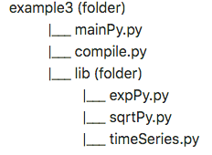
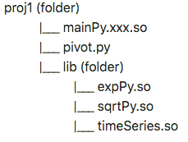
主程式
主程式
入口程式
模組1
模組1
模組2
模組2
模組3
模組3

Slide 3
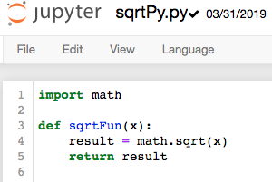
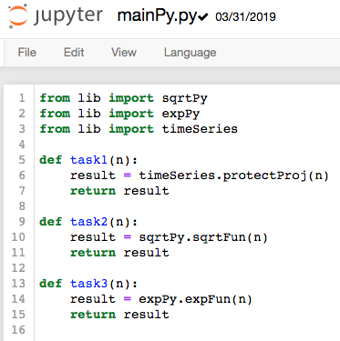
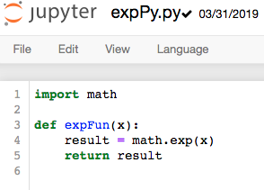
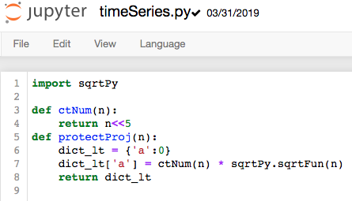

Slide 4
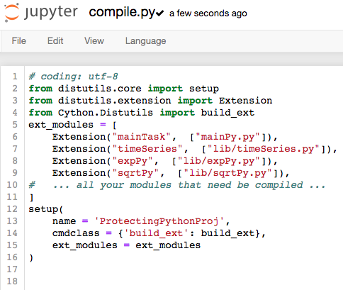
主程式
模組1
模組2
模組3

Slide 5
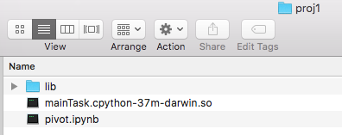
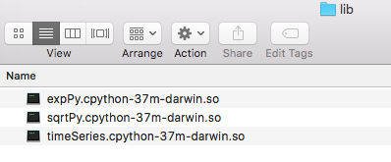
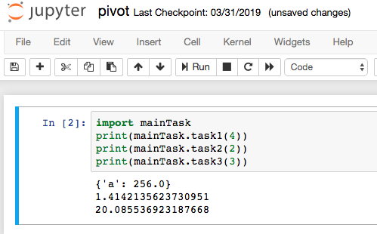
主程式
入口程式
模組1
模組2
模組3

Slide 6
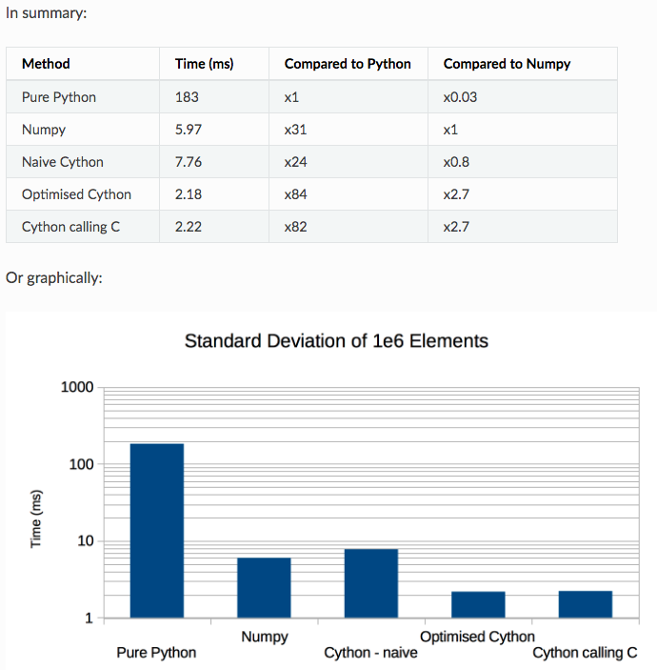
The conclusions from the experiment results are:
- Numpy is around 30x faster than pure Python in this case.
- Surprisingly Numpy was not the fastest, even naive Cython can get close to its performance.
- Optimised Cython and pure ‘C’ beat Numpy by a significant margin (x2.7)
- Optimised Cython performs as well as pure ‘C’ but the Cython code is rather opaque.
Notes:
Ref: https://notes-on-cython.readthedocs.io/en/latest/std_dev.html

